Slide 1
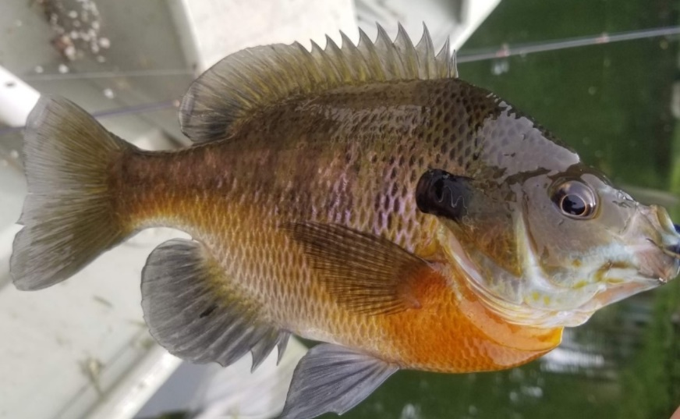
Your Child
FIRST FISH AWARD
is hereby granted to:
Species: Bluegill
Size: 5 inches
Caught: Big Lake
Date: August 12, 2020
Presenter’s Name and Title
Brought to you by ThrillFishing.com

