Slide 1
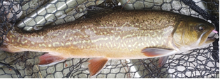
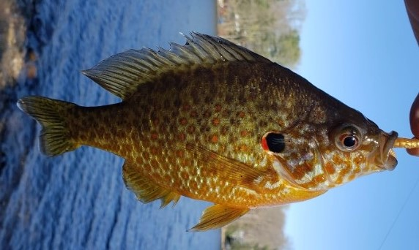
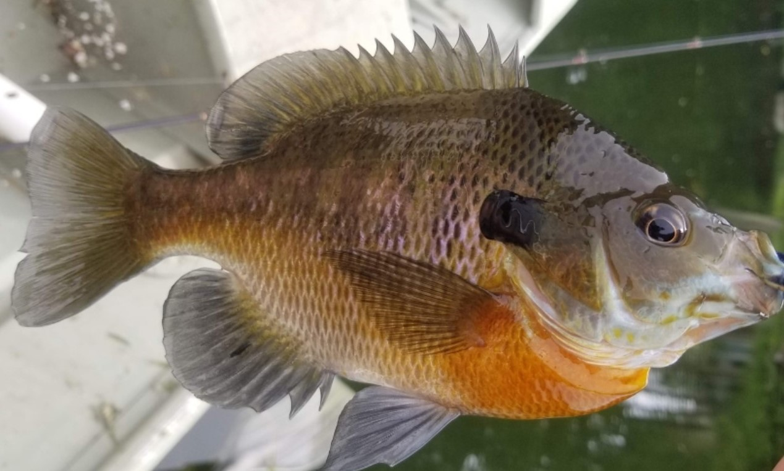
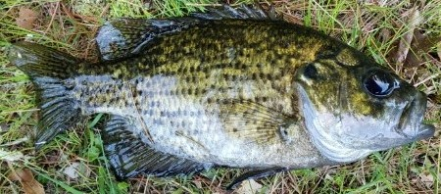
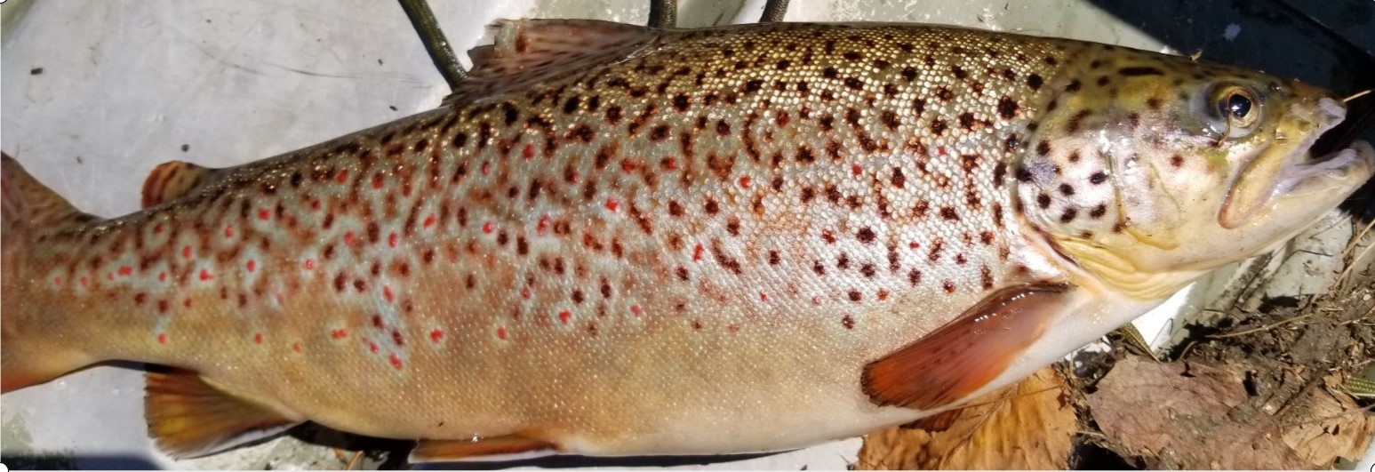
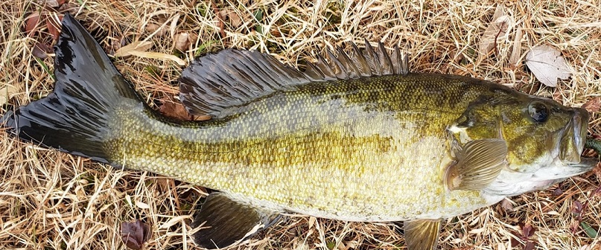
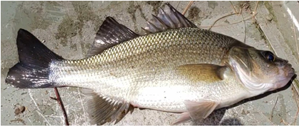
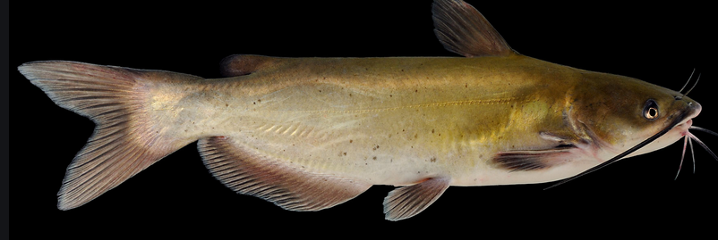
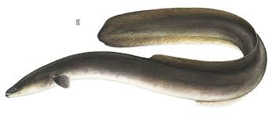
Freshwater Fish Species Bucket List
Species | Date Caught | Size
Tiger Trout
Rainbow Trout
Brook Trout
Brown Trout
Smallmouth Bass
Largemouth Bass
Catfish
Species | Date Caught | Size
Pumpkin Seed
Bluegill
Pickerel
Rock Bass
Yellow Perch
White Perch
American Eel
Anglers Name

